Slide 1

Sales Insights
Eng. Mohamed Yahia Dr. Anas

Slide 2
Aims Grid
Purpose: To unlock valuable sales insights previously unavailable to the sales team, supporting better decision-making. This also includes automating processes to reduce the manual effort spent on data collection and analysis. | Stakeholders: Sales Director: Key decision-maker looking for actionable insights. Marketing Team: Uses the data to adjust strategies and target profitable markets. Customer Service Team: Improves customer satisfaction based on data-driven insights. Data & Analytics Team: Monitors and ensures data integrity and insights generation. IT Department: Supports infrastructure and resolves technical issues related to the dashboard.
End Result: A fully automated, interactive dashboard providing up-to-date sales insights that empower teams to make data-driven decisions quickly and effectively. | Success Criteria: Dashboards provide real-time sales insights, enabling the team to make timely decisions. Sales team achieves better decisions that improve cost efficiency by at least 10%. Analysts save 20% of their time by automating data gathering, allowing them to focus on value-added activities.

Slide 3




Data Import from SQL Server
Data Visualization
Users
Database
Database

Slide 4
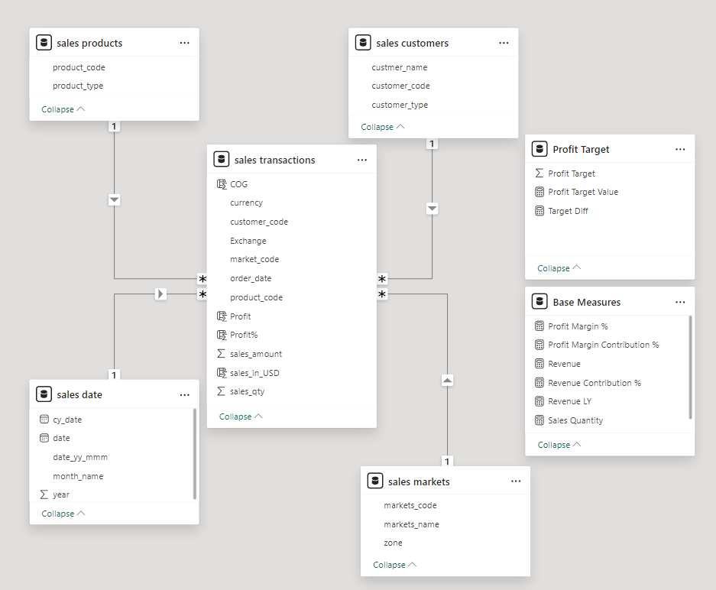
Star schema
What is a Star Schema?
A Star Schema is a type of database schema that organizes data into fact and dimension tables, making it simple to use for analysis.
The Fact Table is at the center, holding quantitative data (e.g., sales transactions), while Dimension Tables surround it, holding descriptive data (e.g., products, dates, markets).
Benefits of Star Schema:
Simplifies Queries: By organizing data into dimensions, querying becomes easier, which is critical for tools like Power BI.
Optimizes Performance: It’s designed for efficient read operations, making it fast to retrieve insights.
Supports Data Visualization: The clear structure is ideal for dashboards like yours, where the relationships between tables are key to building effective visuals.

Slide 5
Data Cleaning
Data Cleaning Process Using Power Query (DAX):
Employed DAX (Data Analysis Expressions) in Power Query within Power BI to automate the data cleaning process, ensuring consistency and accuracy across the dataset.
Key Data Cleaning Steps:
Handling Negative and Zero Values:
Removed transactions with negative and zero values, as they distort metrics like revenue and profit.
Currency Conversion:
Applied a consistent currency exchange process to convert all transactions into a unified currency for accurate comparison across markets.
Removing Null Values:
Removed null values in key fields (e.g., customer codes, product codes) to maintain data integrity.
Removing Duplicated Data:
Eliminated duplicate records to ensure accurate analysis and avoid counting the same transaction multiple times.

Slide 6
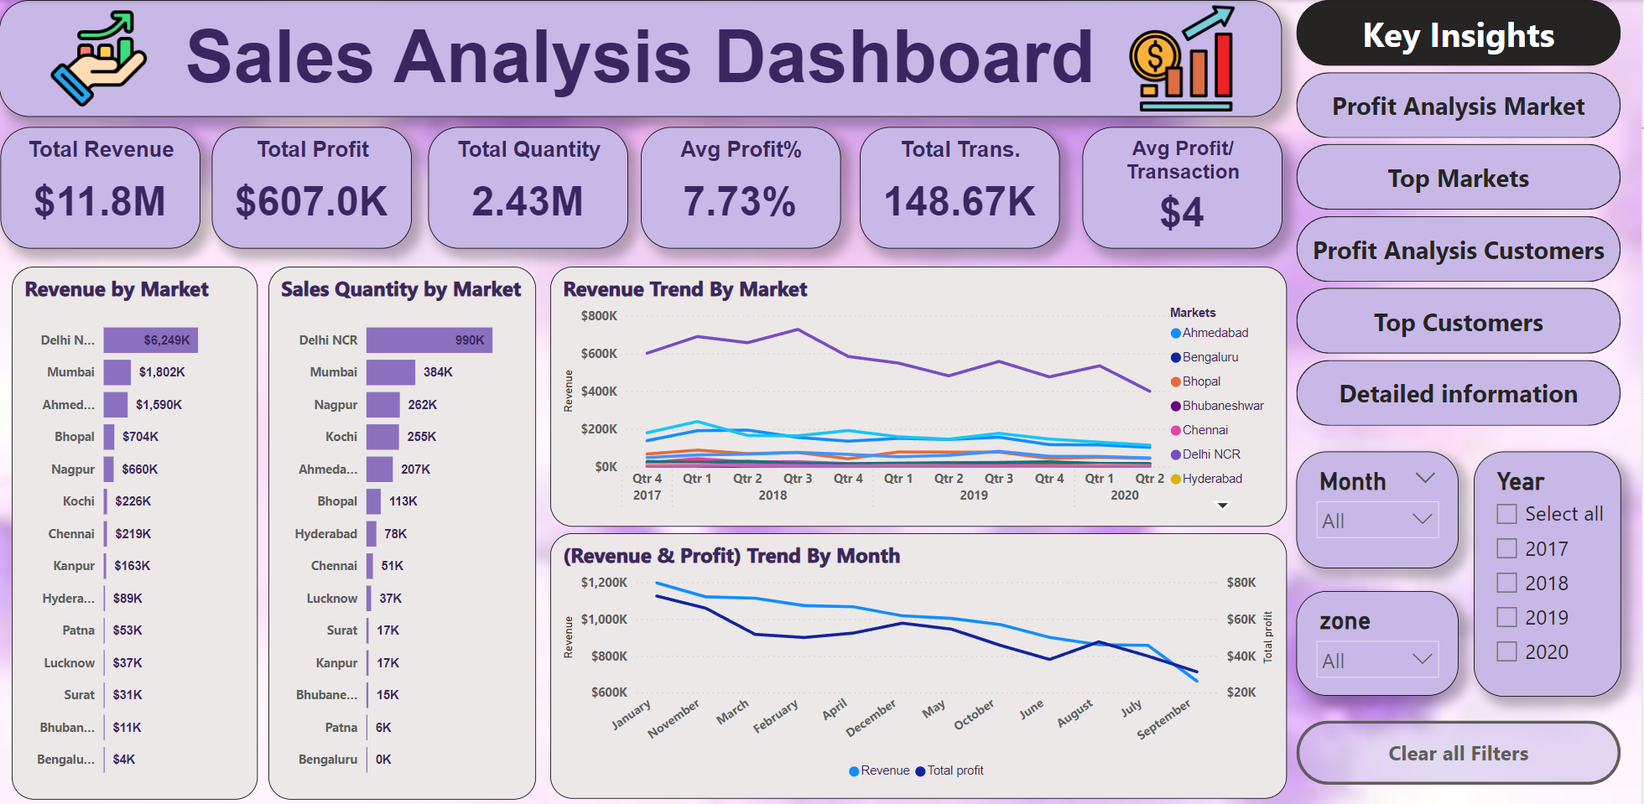
Overview of the Dashboard Design
Key Metrics

Slide 7
Overview of the Dashboard Design
Navigation

Slide 8
Overview of the Dashboard Design
Filters

Slide 9
Overview of the Dashboard Design
Data Visualization

Slide 10
Overview of the Dashboard Design
Notes:
Top Markets Performance (Page 10):
The first visualization shows the top markets by revenue. We can see that Delhi NCR contributes significantly to total sales, followed by Mumbai and Ahmedabad. This tells us that Delhi NCR is a key driver of revenue, and resources should be allocated to support this high-performing market.
Insights: Focus marketing and sales efforts on maintaining and growing the top-performing markets, especially Delhi NCR.

Slide 11
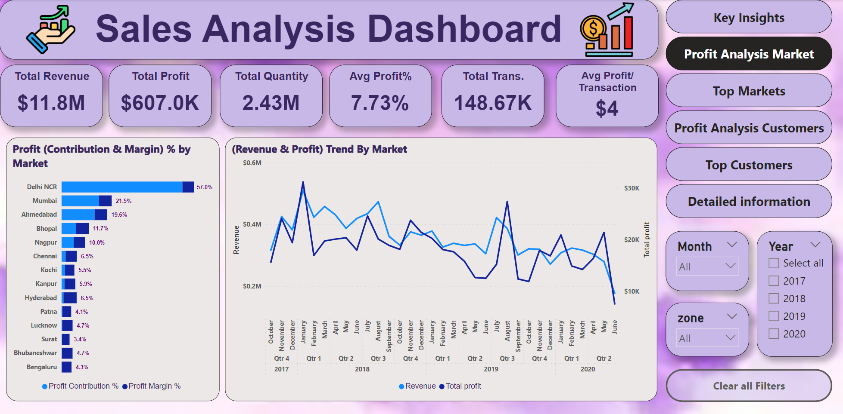
Overview of the Dashboard Design
Notes:
Revenue Trend by Market (Page 11):
The next visualization presents a revenue trend over time by market. This graph highlights how each market's revenue fluctuates over different quarters and years. It’s clear that certain markets experience spikes in specific quarters, suggesting seasonal trends or market-specific events.
Insights: Plan sales and marketing strategies around these seasonal patterns to maximize revenue during high-performing periods.

Slide 12
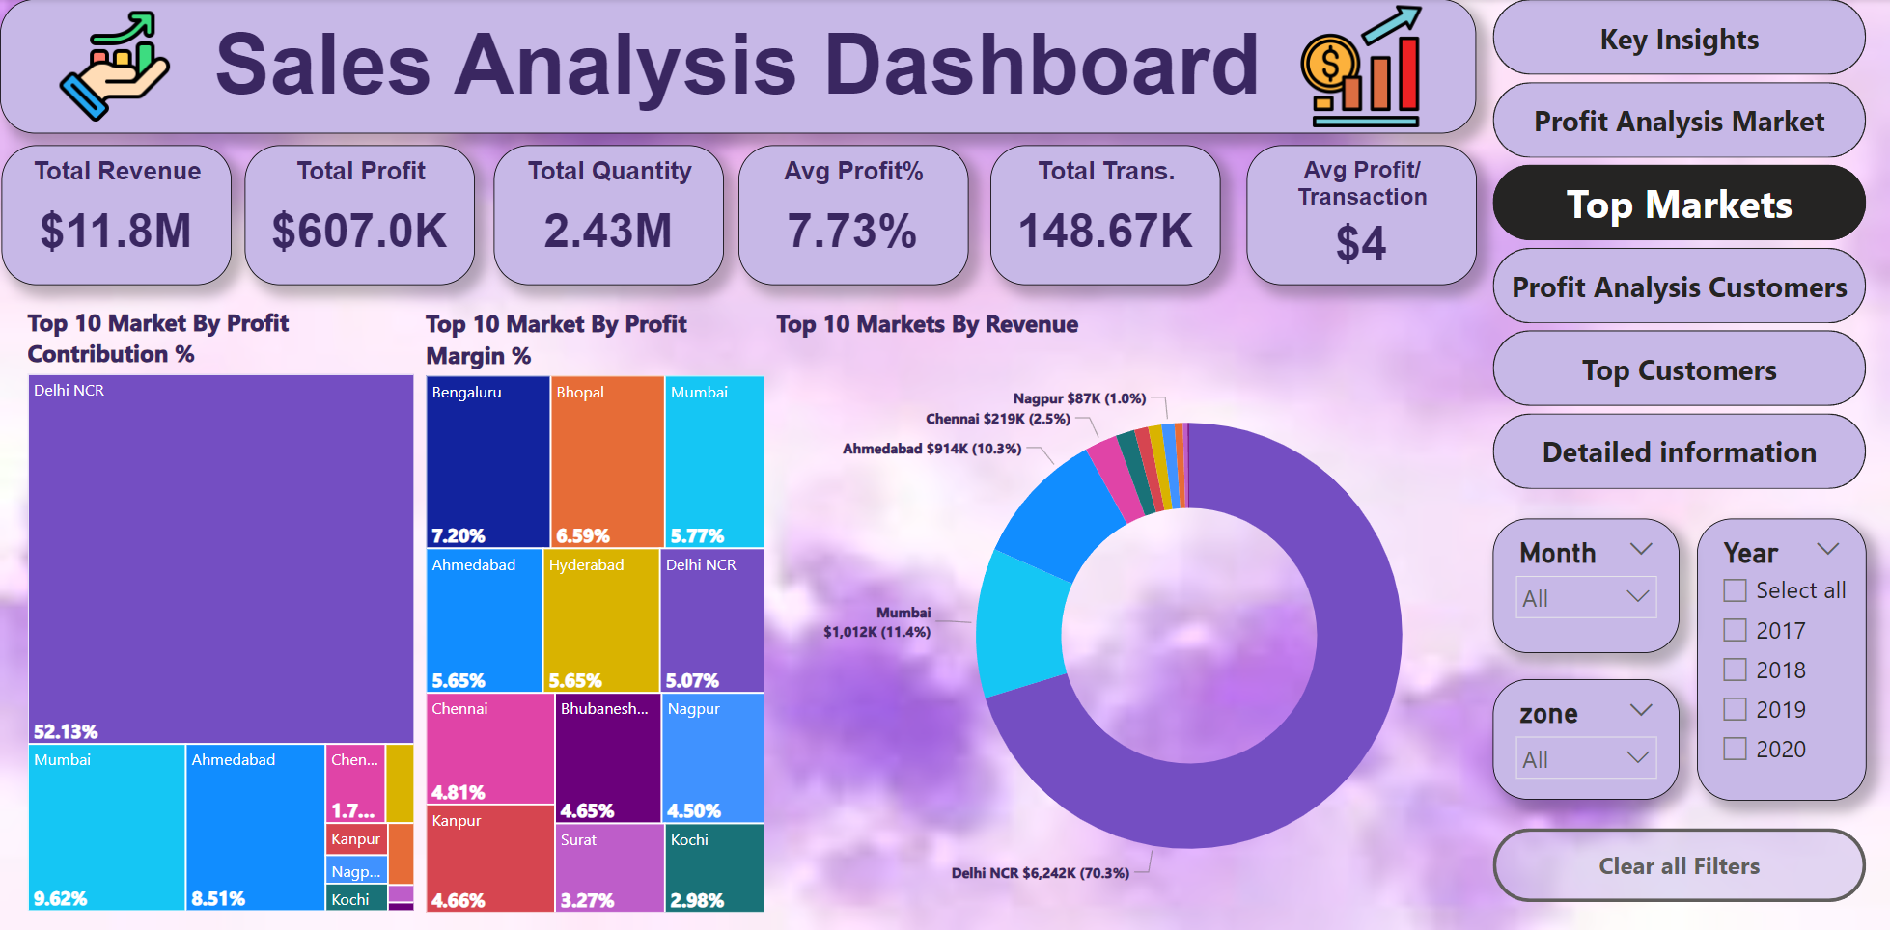
Overview of the Dashboard Design
Notes:
Profit Contribution and Margin (Page 12):
Here, we analyze profit contribution and margin by market. The visualization indicates that although Delhi NCR leads in revenue, other markets like Mumbai and Ahmedabad show a strong profit margin. This suggests that while Delhi NCR drives revenue, profitability may be better in other markets.
Insights: Consider balancing focus between revenue-heavy markets and those with higher profit margins for optimal financial results.

Slide 13
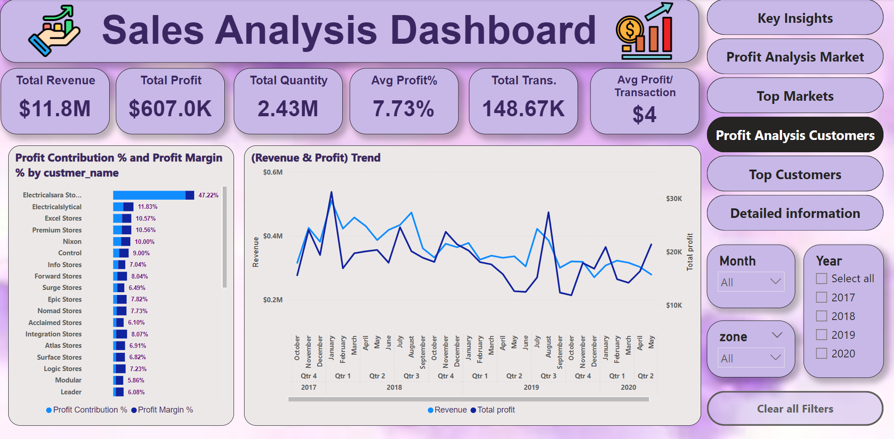
Overview of the Dashboard Design
Notes:
Top Customers by Revenue and Profit (Page 13):
This chart breaks down the top customers by revenue and their corresponding profit contributions. Electricalsara Stores is the top customer, providing substantial revenue and profit, making it a crucial account to maintain.
Insights: Prioritize key customers like Electricalsara Stores for retention strategies, while also identifying opportunities to grow smaller, profitable customers.

Slide 14
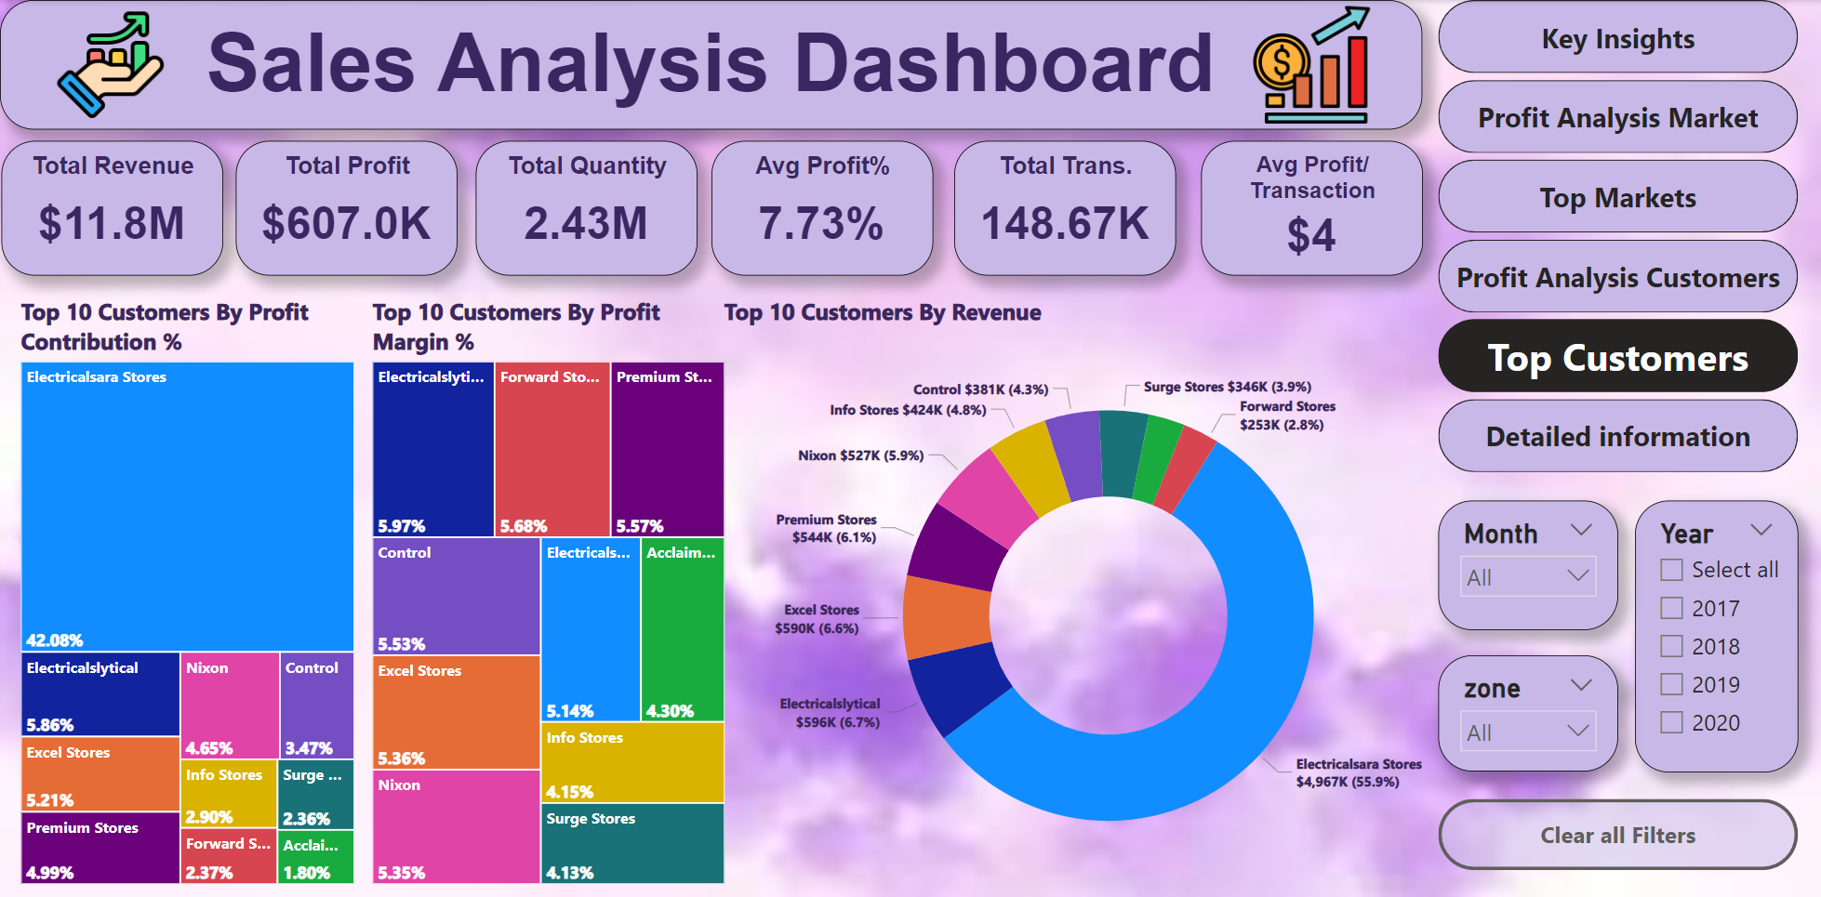
Overview of the Dashboard Design
Notes:
Revenue and Profit Trends by Month (Page 14):
Monthly trends in revenue and profit are visualized here. We can see how revenue aligns with profit trends across different months, helping to pinpoint periods of low profitability despite high revenue.
Insights: Investigate months where revenue is high but profit margins are low, and explore cost-cutting or efficiency measures during those periods.

Slide 15
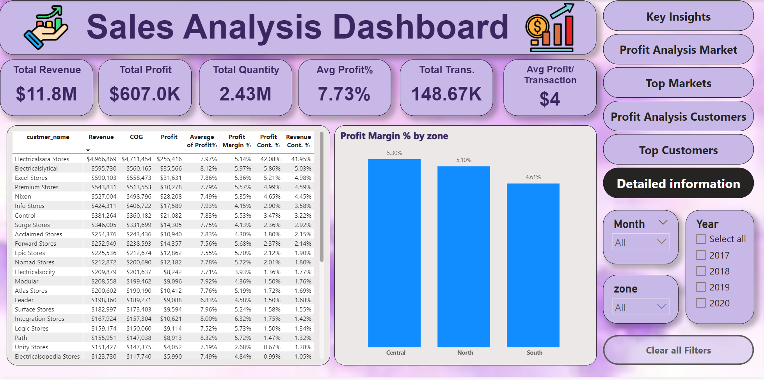
Overview of the Dashboard Design
Notes:
Sales Quantity by Market (Page 15):
This visualization provides an overview of sales quantity across different markets. It's useful for identifying markets with high sales volume but lower revenue, indicating potential pricing or product mix issues.
Insights: Assess whether high-volume markets, such as Nagpur, could benefit from price optimization strategies to increase profitability.

Slide 16
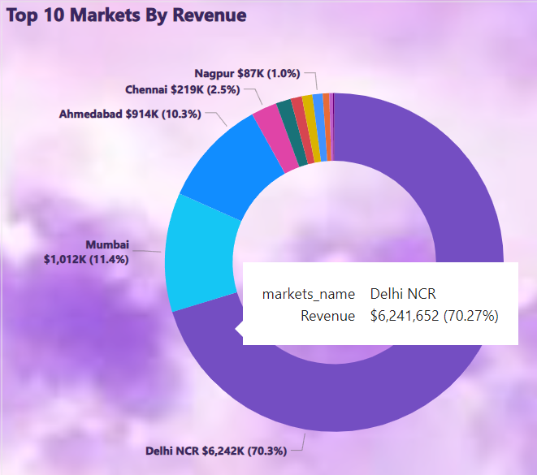
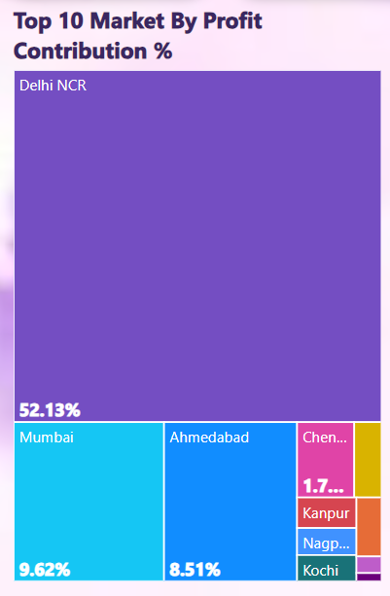
Actionable Steps for Leaders to Increase Profit
1- Optimize Focus on High Revenue Markets
Advice: Allocate more resources, such as marketing campaigns and sales efforts, to Delhi NCR, which shows the highest revenue.
Reason: As seen in the "Top Markets by Revenue" chart, Delhi NCR significantly outperforms other regions. Maximizing efforts in this market could drive further growth.
Action Steps:
Invest in targeted marketing for this region to maintain and grow its revenue share.
Implement localized offers or promotions to capture more market share.
Notes:
تحسين التركيز على الأسواق ذات الإيرادات العالية
النصيحة: خصص المزيد من الموارد، مثل الحملات التسويقية والجهود البيعية، لسوق Delhi NCR، الذي يظهر أعلى الإيرادات.
السبب: كما يظهر في الرسم البياني "Top Markets by Revenue"، تتفوق Delhi NCR بشكل كبير على الأسواق الأخرى. زيادة الجهود في هذا السوق يمكن أن تدفع نموًا إضافيًا.
الخطوات العملية:
الاستثمار في التسويق الموجه لهذا السوق للحفاظ على حصته في السوق وزيادتها.
تقديم عروض أو خصومات محلية لجذب حصة أكبر من السوق.

Slide 17
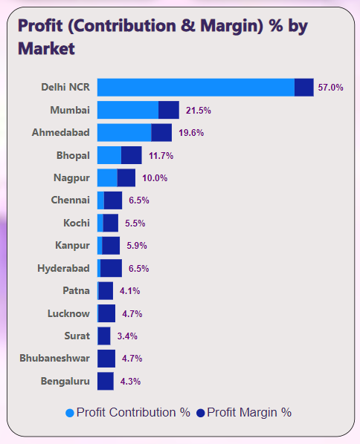
Actionable Steps for Leaders to Increase Profit
2- Improve Profit Margins in High Revenue Markets
Advice: Focus on improving profit margins in Delhi NCR and other revenue-heavy markets by analyzing cost structures and pricing strategies.
Reason: While Delhi NCR leads in revenue, the Profit Contribution & Margin by Market chart reveals that profit margins in this market are not as strong as in other regions.
Action Steps:
Reevaluate pricing strategies and reduce costs through supply chain efficiencies.
Implement margin-based incentives for sales teams to prioritize profitable sales.
Notes:
تحسين هوامش الربح في الأسواق ذات الإيرادات العالية
النصيحة: ركز على تحسين هوامش الربح في Delhi NCR والأسواق الأخرى ذات الإيرادات العالية من خلال تحليل هيكل التكاليف واستراتيجيات التسعير.
السبب: على الرغم من أن Delhi NCR تتصدر الإيرادات، إلا أن الرسم البياني "Profit Contribution & Margin by Market" يظهر أن هوامش الربح في هذا السوق ليست قوية مثل الأسواق الأخرى.
الخطوات العملية:
إعادة تقييم استراتيجيات التسعير وتقليل التكاليف من خلال تحسينات في سلسلة التوريد.
تنفيذ حوافز قائمة على الهامش لفريق المبيعات لتعزيز المبيعات ذات الربحية العالية.

Slide 18
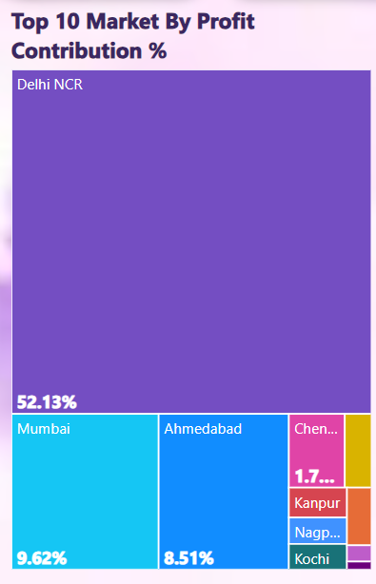
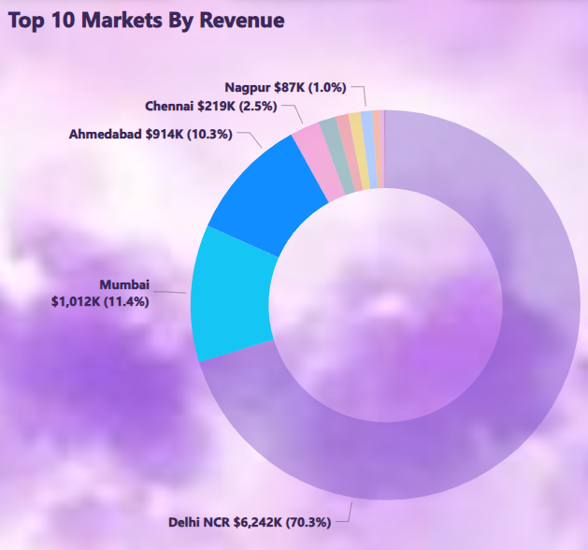
Actionable Steps for Leaders to Increase Profit
3- Maximize Profit from Smaller but High-Margin Markets
Advice: Pay close attention to markets like Mumbai and Ahmedabad, which, although smaller in revenue, show higher profit margins.
Reason: The "Profit Margin by Market" chart indicates that these markets have strong profitability potential, which should not be overlooked.
Action Steps:
Increase sales efforts and focus on growing these markets by expanding product offerings.
Consider creating exclusive, higher-margin products for these regions to capitalize on existing strengths.
Notes:
زيادة الربحية في الأسواق الصغيرة ذات الهامش العالي
النصيحة: الاهتمام بشكل أكبر بالأسواق مثل Mumbai وAhmedabad، والتي على الرغم من أنها أصغر من حيث الإيرادات، تظهر هوامش ربح أعلى.
السبب: الرسم البياني "Profit Margin by Market" يشير إلى أن هذه الأسواق تتمتع بإمكانية ربحية قوية ويجب عدم إغفالها.
الخطوات العملية:
زيادة الجهود البيعية والتركيز على توسيع هذه الأسواق من خلال توسيع نطاق المنتجات المتاحة.
النظر في تقديم منتجات حصرية ذات هوامش ربح أعلى لهذه المناطق للاستفادة من نقاط القوة الحالية.

Slide 19
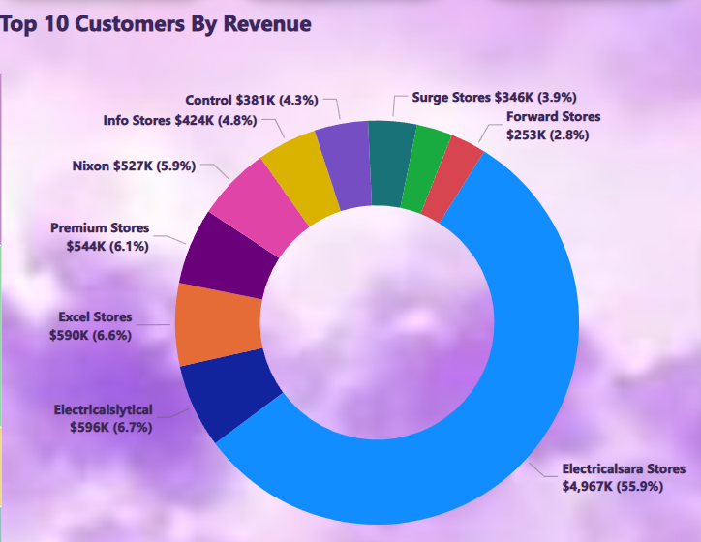
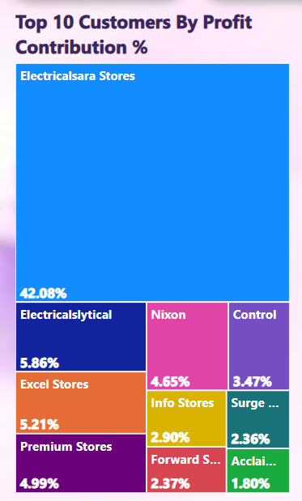
Actionable Steps for Leaders to Increase Profit
4- Nurture High-Value Customers
Advice: Prioritize customer retention and expansion strategies for top-performing customers like Electricalsara Stores, which significantly contribute to both revenue and profit.
Reason: The "Top Customers by Revenue and Profit Contribution" charts highlight that Electricalsara Stores and similar top-tier customers generate a large portion of profits.
Action Steps:
Implement loyalty programs or exclusive offers for top customers to increase retention.
Offer value-added services such as dedicated account managers to build deeper relationships.
Notes:
التركيز على العملاء ذوي القيمة العالية
النصيحة: إعطاء الأولوية لاستراتيجيات الاحتفاظ بالعملاء والتوسع مع العملاء الأعلى أداءً مثل Electricalsara Stores التي تسهم بشكل كبير في كل من الإيرادات والأرباح.
السبب: الرسوم البيانية "Top Customers by Revenue and Profit Contribution" توضح أن Electricalsara Stores والعملاء من نفس الفئة يولدون جزءًا كبيرًا من الأرباح.
الخطوات العملية:
تنفيذ برامج الولاء أو تقديم عروض حصرية للعملاء الرئيسيين لزيادة الاحتفاظ بهم.
تقديم خدمات ذات قيمة مضافة مثل مديري حسابات مخصصين لتعزيز العلاقات بشكل أعمق.

Slide 20
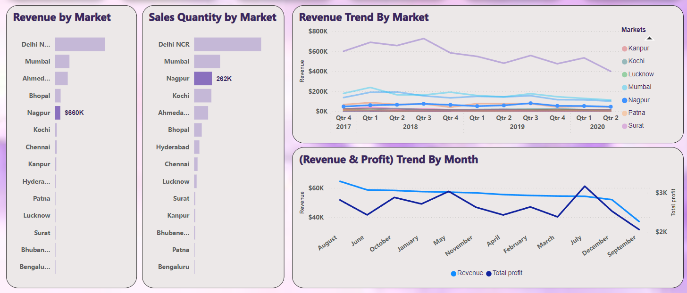
Actionable Steps for Leaders to Increase Profit
5- Optimize Pricing and Promotions for High Volume, Low-Profit Markets
Advice: In markets like Nagpur where sales volume is high but revenue is relatively low, introduce price optimization and promotional strategies to increase profitability.
Reason: The "Sales Quantity by Market" chart shows Nagpur as a high-volume market, but its low revenue indicates an opportunity to adjust pricing or product mix.
Action Steps:
Conduct a pricing analysis to explore raising prices slightly without losing volume.
Implement targeted promotions that encourage upselling or the purchase of higher-margin products.
Notes:
تحسين التسعير والعروض الترويجية للأسواق ذات الحجم الكبير والربح المنخفض
النصيحة: في الأسواق مثل Nagpur حيث حجم المبيعات مرتفع ولكن الإيرادات منخفضة نسبيًا، تقديم استراتيجيات تحسين الأسعار والعروض الترويجية لزيادة الربحية.
السبب: الرسم البياني "Sales Quantity by Market" يظهر أن Nagpur سوق ذو حجم مبيعات كبير، لكن الإيرادات المنخفضة تشير إلى فرصة لضبط التسعير أو مزيج المنتجات.
الخطوات العملية:
إجراء تحليل للتسعير لاستكشاف إمكانية رفع الأسعار قليلاً دون فقدان حجم المبيعات.
تنفيذ عروض ترويجية موجهة تشجع على الشراء المتزايد أو شراء المنتجات ذات الهوامش الربحية الأعلى.

Slide 21
Thanks!
Questions?
Notes:
تحسين التسعير والعروض الترويجية للأسواق ذات الحجم الكبير والربح المنخفض
النصيحة: في الأسواق مثل Nagpur حيث حجم المبيعات مرتفع ولكن الإيرادات منخفضة نسبيًا، تقديم استراتيجيات تحسين الأسعار والعروض الترويجية لزيادة الربحية.
السبب: الرسم البياني "Sales Quantity by Market" يظهر أن Nagpur سوق ذو حجم مبيعات كبير، لكن الإيرادات المنخفضة تشير إلى فرصة لضبط التسعير أو مزيج المنتجات.
الخطوات العملية:
إجراء تحليل للتسعير لاستكشاف إمكانية رفع الأسعار قليلاً دون فقدان حجم المبيعات.
تنفيذ عروض ترويجية موجهة تشجع على الشراء المتزايد أو شراء المنتجات ذات الهوامش الربحية الأعلى.

